Slide 1
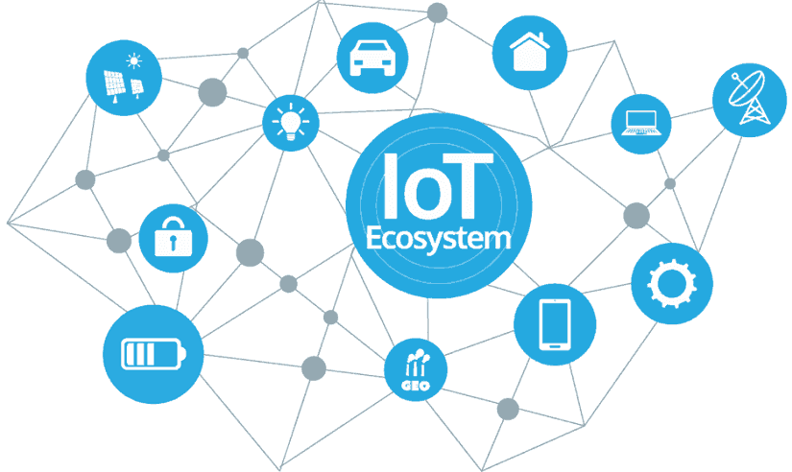

Microsoft Azure IoT & Azure MXChip IoT DevKit

Slide 2
Agenda
IoT Overview
IoT Real World Examples
Microsoft Azure IoT Services
Azure MXChip IoT DevKit Overview
Demo
Resources
Q&A

Slide 3








Who Am I?
.NET/Azure Engineer at Billennium
Traveling, soccer & cycling
maciejskuratowski@gmail.com
mskuratowski.com
@mskuratowski
m.skuratowski
https://github.com/mskuratowski

Slide 4
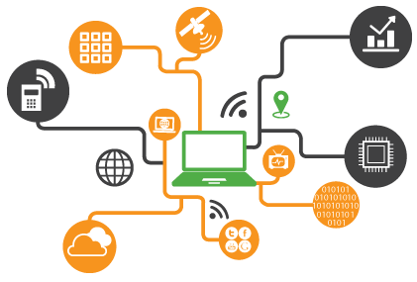
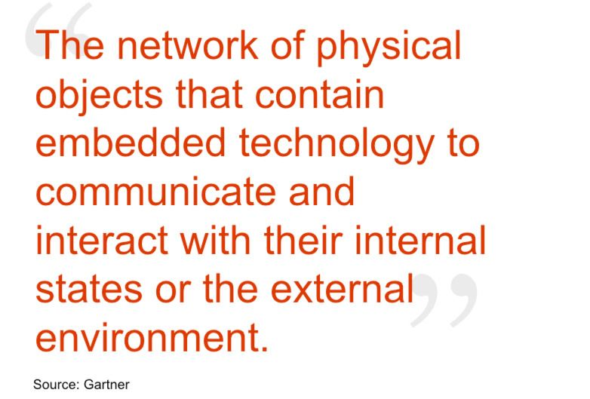
IoT overview

Slide 5
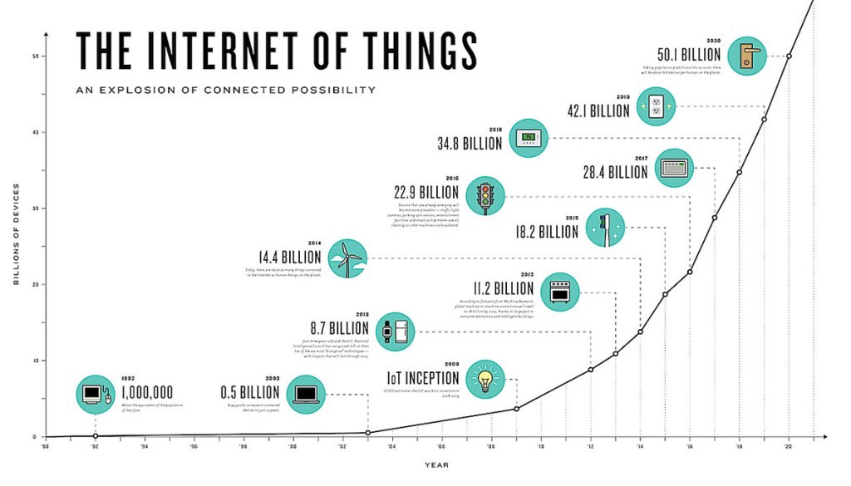

Slide 6
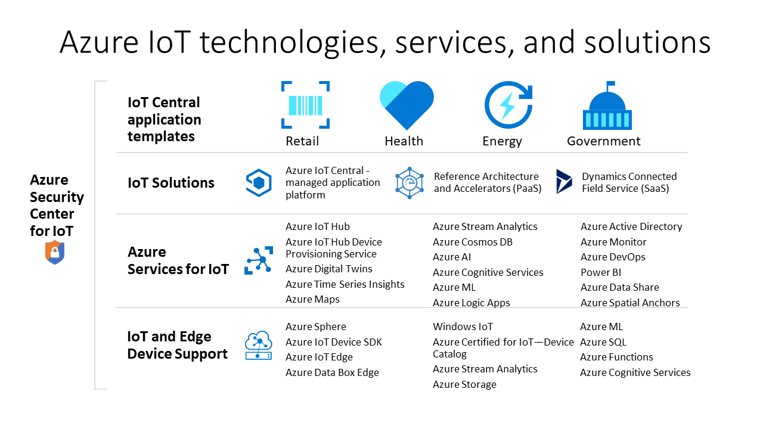

Slide 7
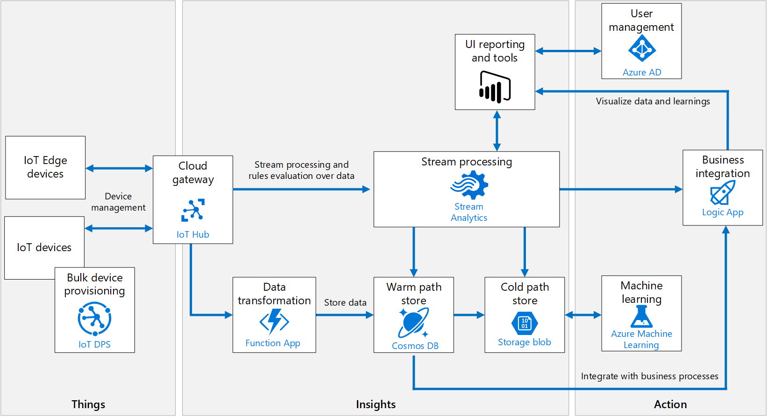

Slide 8
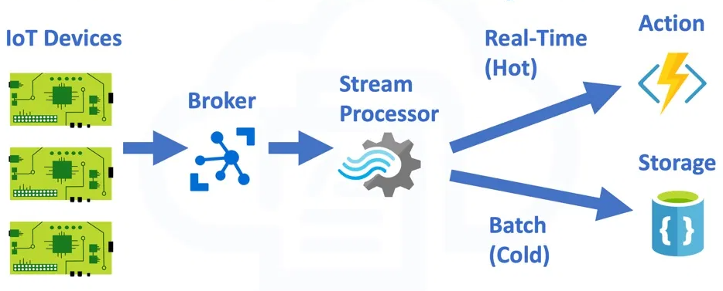

Slide 9
Azure IoT solution accelerators
End-to-end implementation
Completely customizable
Open-source microservices based architecture
Device connectivity and management
Dashboards, visualization and insights
Workflow automation and integration
Command and control
Preconfiogured solutions

Slide 10
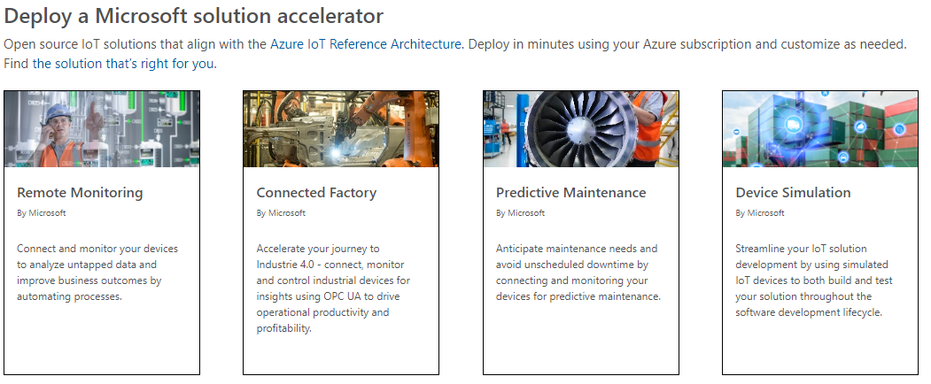
Azure IoT Solution Accelerators

Slide 11

Azure IoT Hub
Bi-directional communication
millions of devices
multi-language, open source SDKs
HTTPS/AMQPS/MQTTS
Send Telemetry
Receive Commands
Device Management
Device Twins
Queries & Jobs
Scale up and down
Azure Monitor
Per Device Certificates
Per Device Enable/Disable
TLS Security
X.509 Support
Firmware/Software Updates

Slide 12
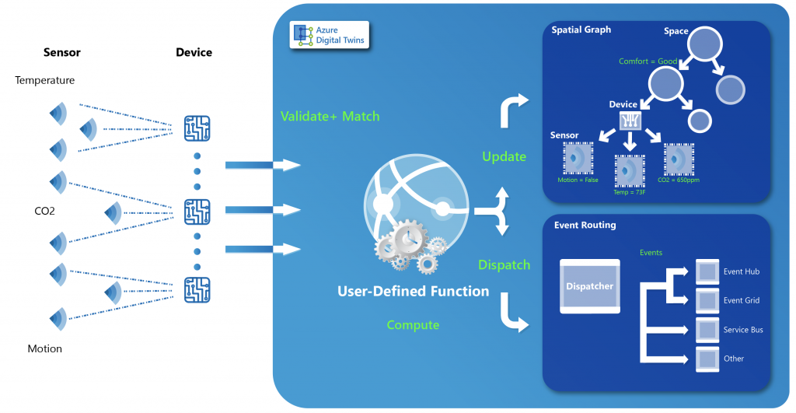
Azure Digital Twins
Twin object models
Spatial intelligence graph
Advanced compute capabilities
Security through access control and Azure AD
Spaces
Devices
Sensors
Users
still in preview

Slide 13

Azure Time Series Insights
Specfic tool to analyze Time-Series data
Automatically infer schema of incoming data
Easily allow visual analysis of time-series data
Storage in-memory and SSD
Easy connection with IoT Hub
Simple and fast navigation

Slide 14
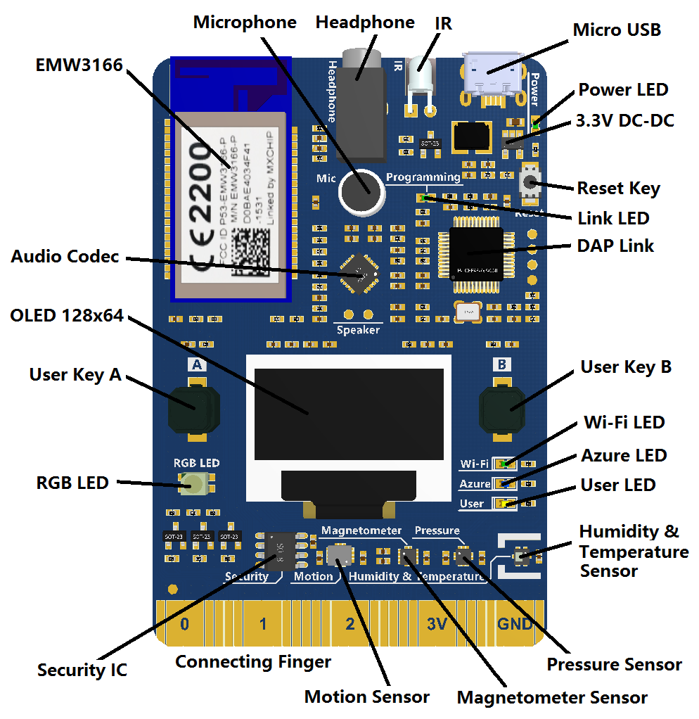
Azure MXChip IoT DevKit Overview

Slide 15
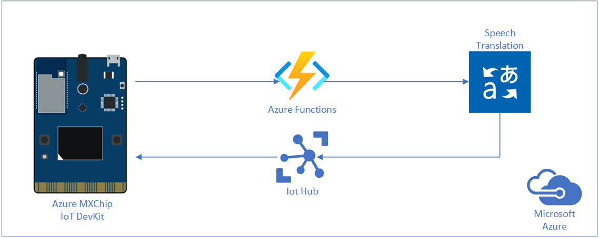
Demo architecture

Slide 16


Slide 17
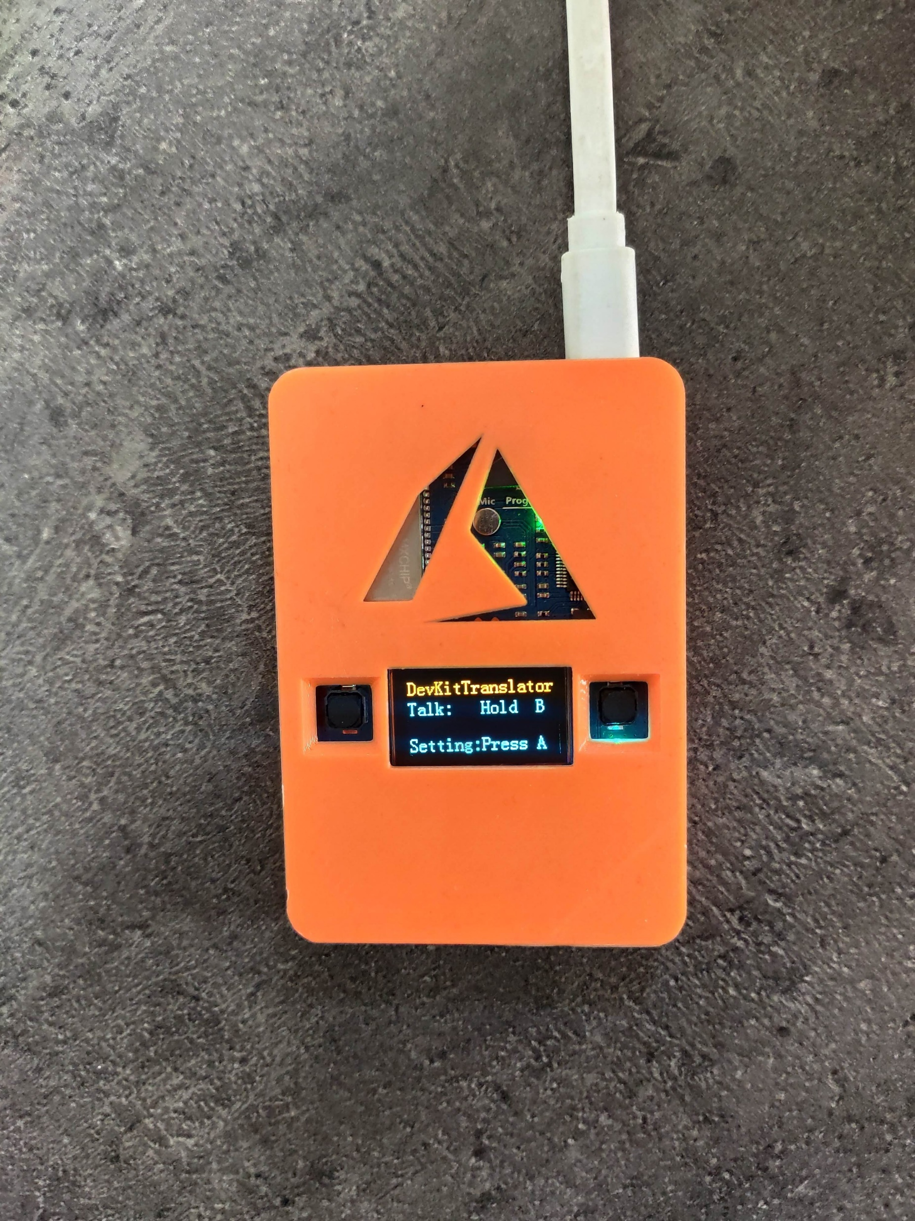
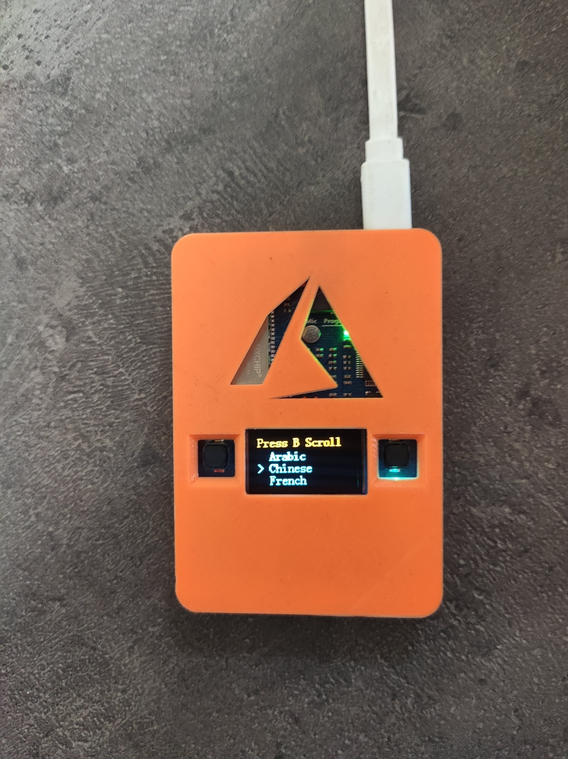
Demo photos

Slide 18
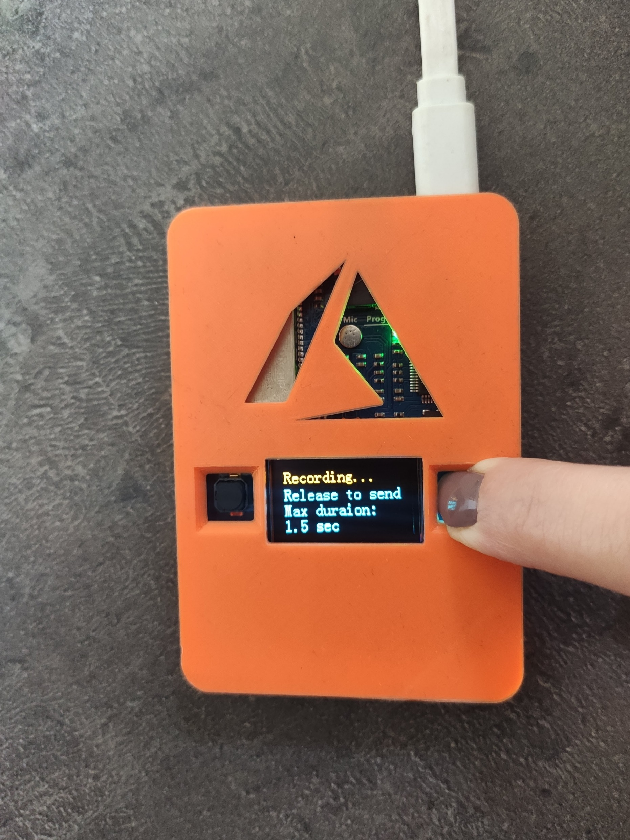
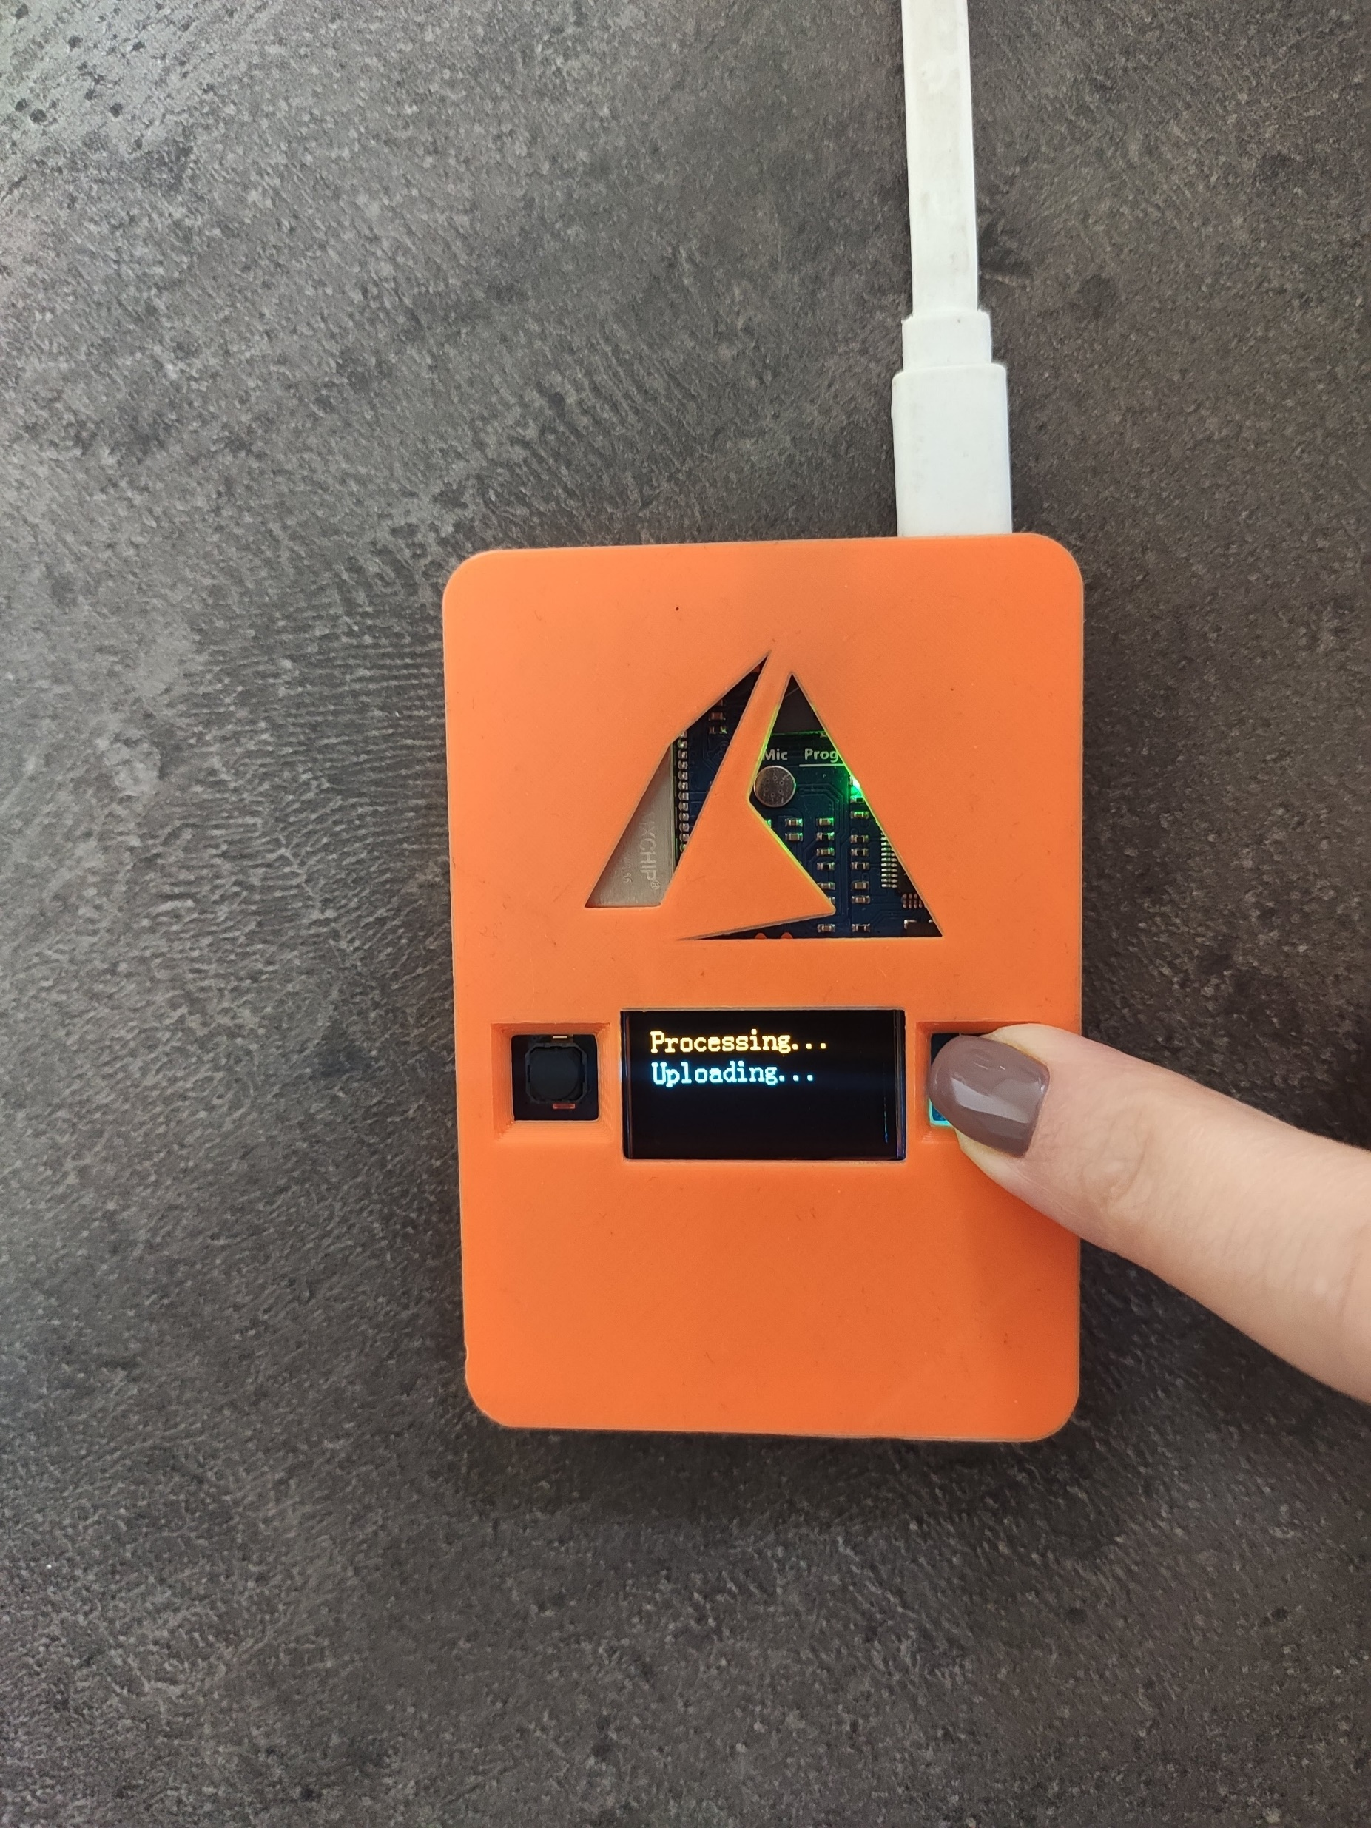
Demo photos

Slide 19
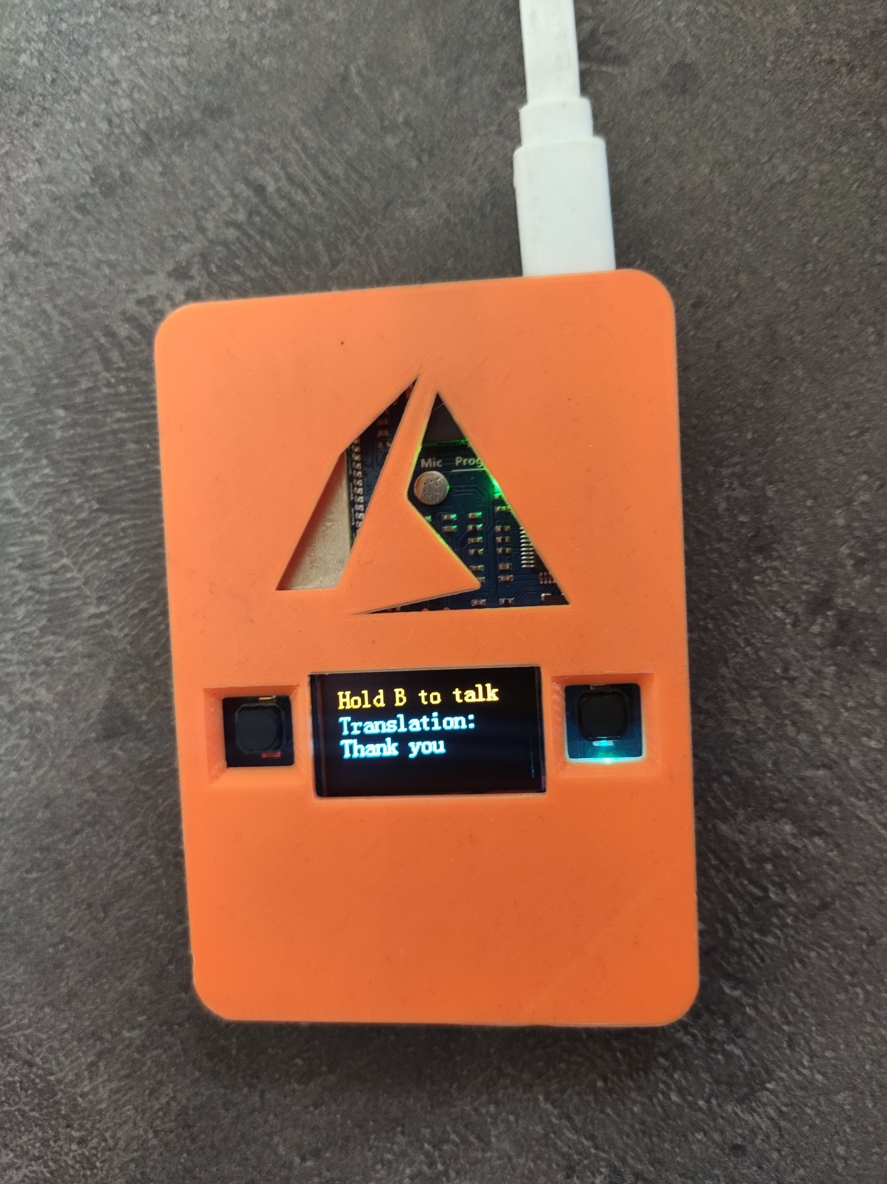
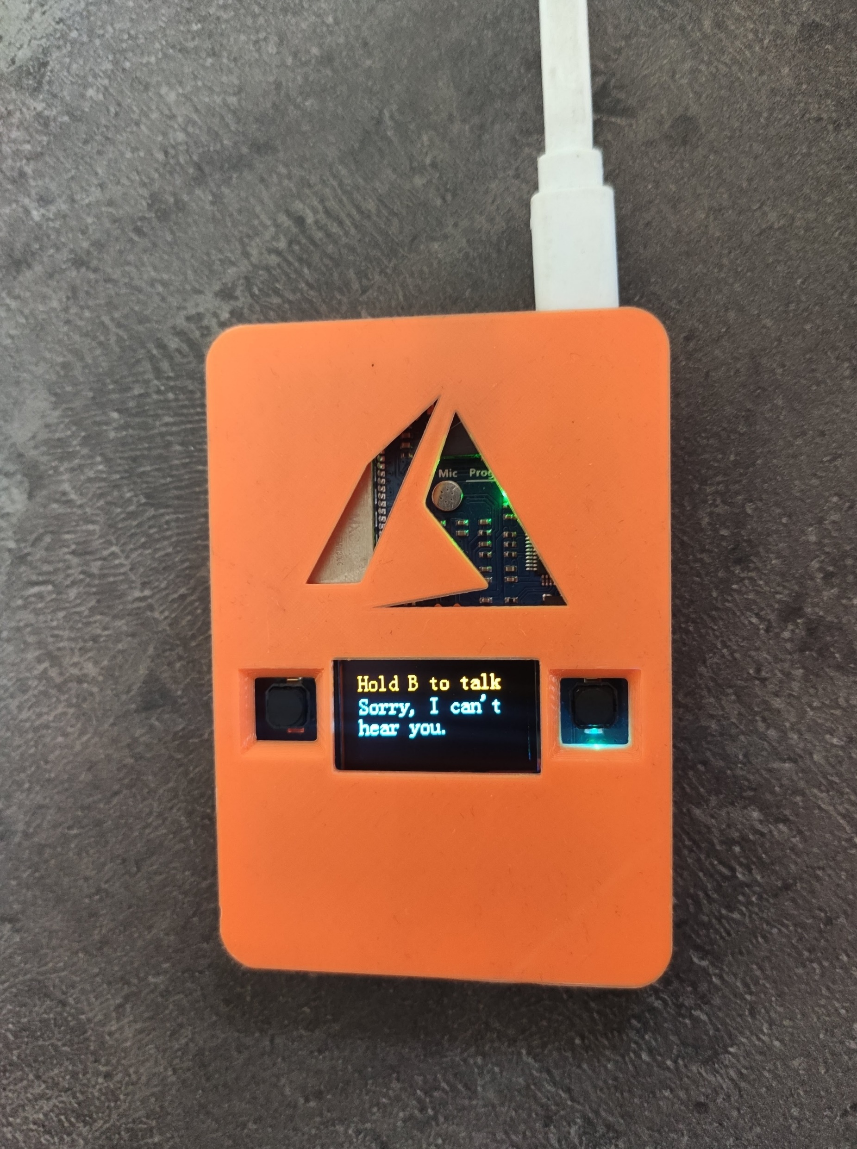
Demo photos

Slide 20
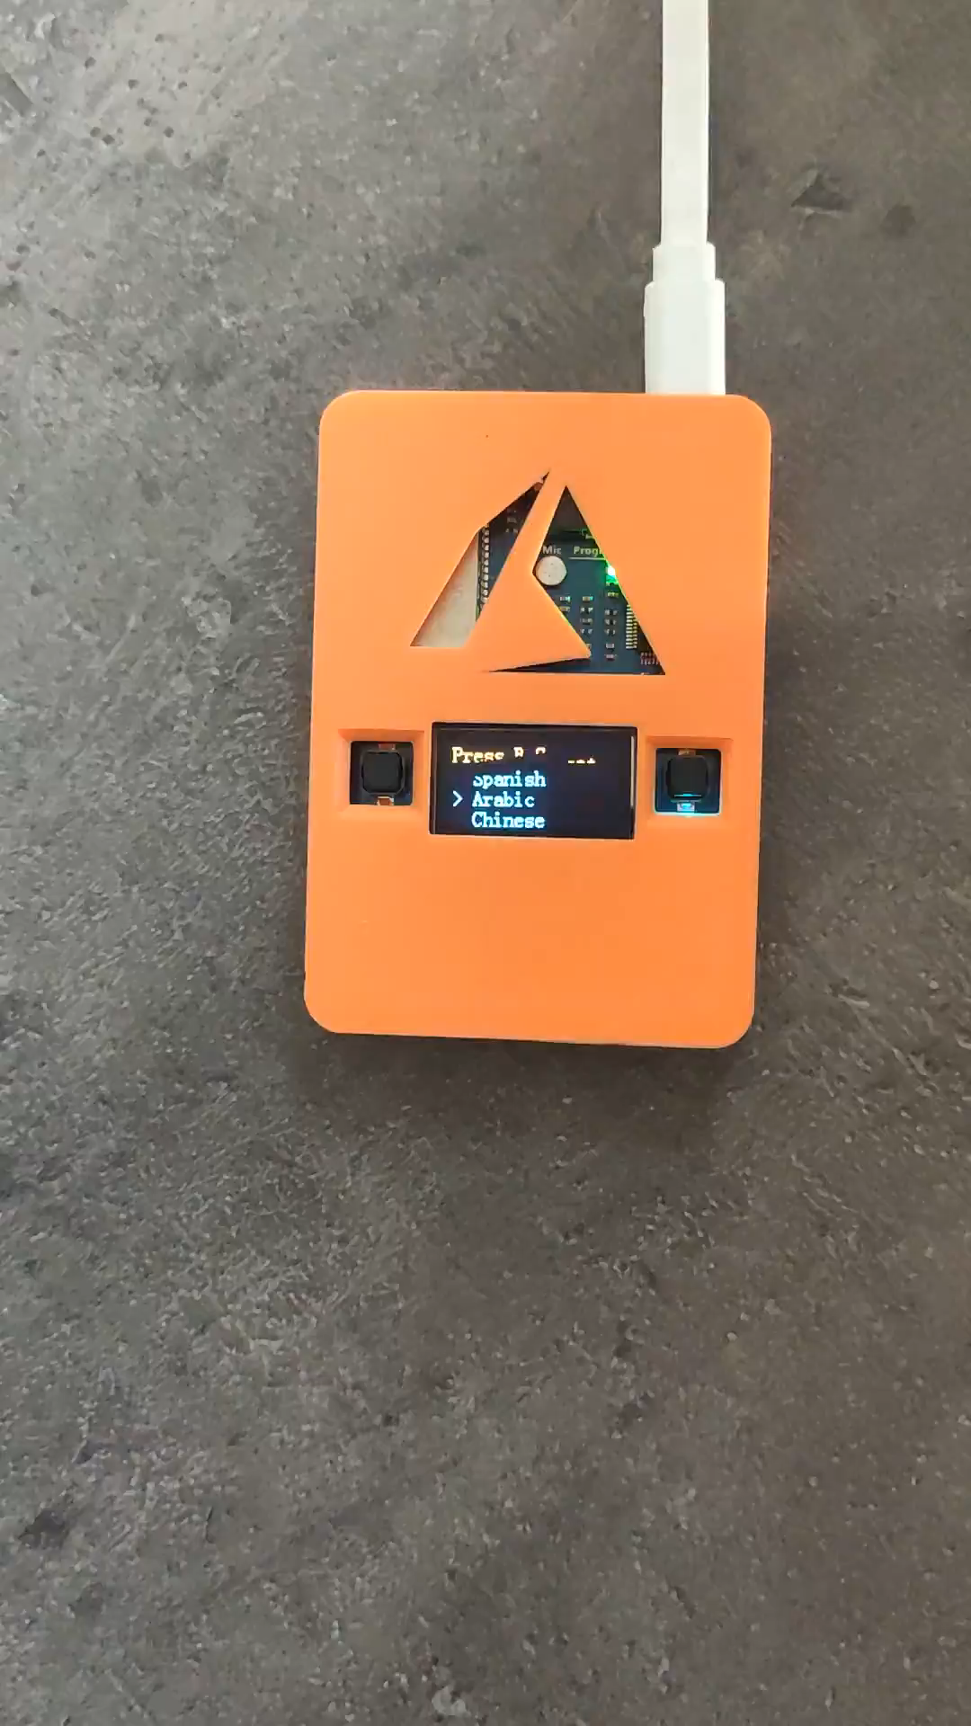

Slide 21
IoT projects can be complex
Difficult to maintain cohesive security
Time-consuming to get started
Incompatibile with existing infrastructure
Challenging to scale over time

Slide 22
Microsoft is simplifying IoT
Easier to build secure, scalable solutions from device to cloud
Easier to provision devices at scale
Easier to manager devices at scale
Easier to find insights from your IoT devices
Easier to infuse devices with intelligence
Easier to benefit from IoT

Slide 23
Steps to the innovation
Cloud
Globally available, unlimited compute resources
IoT
Harnessing signals from sensors and devices, managed centrally by the cloud
Edge
Intelligence offloaded from the cloud to IoT devices
AI
Breakthrough intelligence capabilities, in the cloud and on the edge

Slide 24
Developers SDKs & Tools
Azure SDKs
Open source SDKs for Azure IoT Hub
Github.com/azure/azure-iot-sdks
Service Client SDK – C#, Java, Javascript
Device Client SDK – C, JavaScript, Java, C#
Open source preconfigured solutions for IoT Suite
Tools
X-Plat CLI tool: iothub-explorer
Windows tool: DeviceExplorer

Slide 25
Where to buy?
DFRobot
Amazon
Botland

Slide 26
Resources
IoT DevKit Project Catalog
IoT School
Azure IoT reference architecture
Azure IoT Dev Center
Internet of Things Show
Buy some device and have fun ☺

Slide 27


Slide 28
